Slide 1
Lecture 12 CUDA Parallel Prefix Sum
Kyu Ho Park
May 16, 2017
Ref: Mark Harris, Parallel Prefix Sum with CUDA, NVIDIA

Slide 2
all-prefix-sum
all-prefix-sums operation:
a binary associative operator ⊕, and
an array of n elements [a₀ , a₁ , …. ,a_{n-1} ],
returns the array
[a₀ ,(a₀ ⊕a₁ ),……,(a₀ ⊕ a₁ ⊕…. ⊕a_{n-1} ) ].
If the operator ⊕ is addition, then the all-prefix-sums operation on the array [ 1 2 3 4 5 6 7 ]
returns [1,3,6,10,15,21,28].

Slide 3
scan
scan: the all-prefix-sums operation on an array of data is commonly known as scan.
exclusive scan
[0, a₀ ,(a₀ ⊕a₁ ),……,(a₀ ⊕ a₁ ⊕…. ⊕a_{n-2} ) ].
can represent start point of the array (0)
inclusive scan
[a₀ ,(a₀ ⊕a₁ ),……,(a₀ ⊕ a₁ ⊕…. ⊕a_{n-1} ) ].
represent each portion of the things.

Slide 4
Sequential and Parallel Implementation
Sequential Sum:
y[0]=x[0];
for(int i=1,i<Max_i; i++){
y[i]=y[i-1] + x[i];}
Parallel:
for d=1 to log₂ n do
for all k in parallel do
if k>= 2^{d} then x[k]=x[k-2^{d-1}] + x[k]

Slide 5
Simple Parallel Scan
1 | 2 | 3 | 4 | 5 | 6 | 7 | 8
1 | 3 (1+2) | 5 (2+3) | 7 (3+4) | 9 (4+5) | 11 (5+6) | 13 (6+7) | 15 (7+8)
1 | 3 | 6 (1+5) | 10 (3+7) | 14 (5+9) | 18 (7+11) | 22 (9+13) | 26 (15+11)
1 | 3 | 6 | 10 | 15 (1+14) | 21 (3+18) | 28 (6+22) | 36 (10+26)

Slide 6
inclusive scan algorithm
__global__ void simple_scan_kernel(float *X, float * Y, int InputSize){
__shared__ float XY[SECTION_SIZE];
int i=blockU=Idx.x*blockDim.x + threadx.x;
if(I < InputSize){
XY[threadIdx.x]=X[i];
}
for(unsigne int stride=1;stride<=threadIdx.x;stride*=2){
__syncthreads();
XY[threadIdx.x]+=XY[threadIdx.x-stride];
}
Y[i]=XY[threadIdx.x];
}

Slide 7
work-efficient
A parallel computation is work-efficient if it does asymptotically no more work than the sequential version(O(n)).

Slide 8
Asymptotic Complexity
For a given function g(n),
O(g(n)) = { f(n) | f(n)/g(n) is bounded}
o(g(n)) = { f(n) | f(n)/g(n) → 0 as n→ ∞}.

Slide 9
sequential inclusive scan
void sequential_scan(float *x, float *y, int Max_i){
y[0]=x[0];
for(int i=1,i<Max_i; i++){
y[i]=y[i-1] + x[i];
}
}
This algorithm is work efficient since it requires only one addition, one memory load and one memory store in processing each input element. The complexity is O(n)

Slide 10
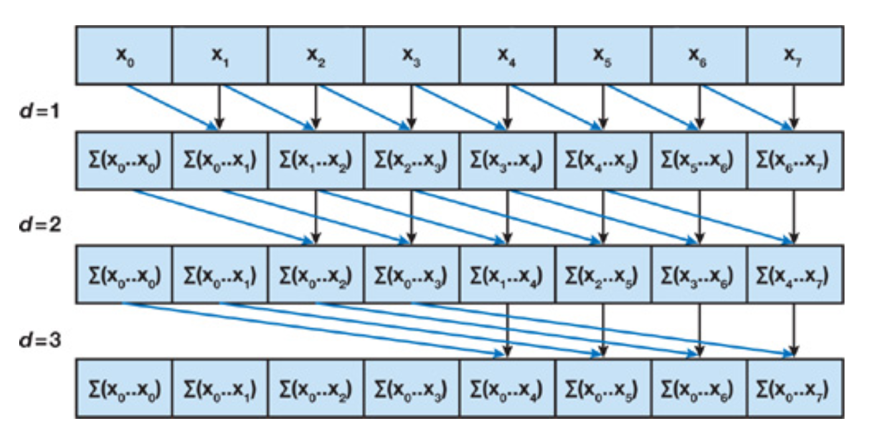
Naïve Parallel Scan

Slide 11
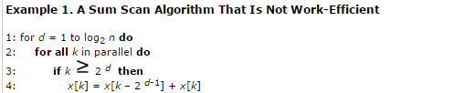
Parallel Sum Scan Algorithm

Slide 12
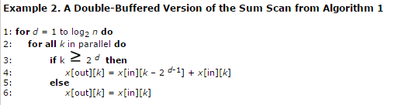
Double Buffered Parallel Sum Scan

Slide 13
Work Efficiency
In case of naïve Parallel scan,
1.All threads will iterate up to log(N) steps,
where N=SECTION_SIZE.
2.The number of calculation,
∑(N-stride) for strides 1,2,4, …, N/2.
[log₂ (N) terms ].
=Nxlog₂ (N) – (N -1)
3. When N=1024,
N-1=1023, Nlog₂ (N)-(N-1)=9217.
not efficiency ! O(NlgN) 이라서 sequential은 O(N)

Slide 14
Work-Efficient Parallel Scan
Balanced trees: A binary tree where the depth of all the leaves differ by at most 1.
Idea: Build a balanced binary tree on the input data and sweep it to and from the root to compute the prefix sum.
Two Phases:
Reduce phase(Up-sweep Phase):
Traverse the tree from leaves to root computing partial sums at internal nodes of tree.
Down-sweep phase:(next slide)

Slide 15
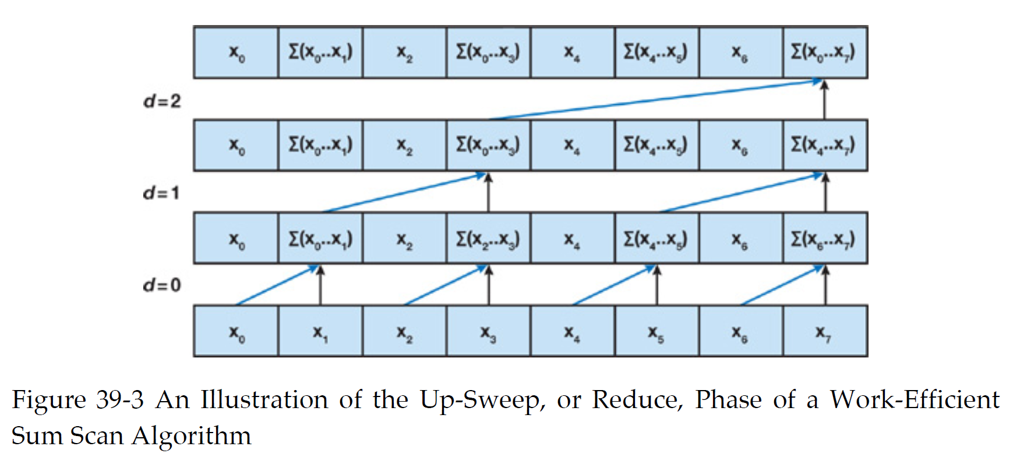
Up-sweep Phase of a Work-Efficient Sum Scan
inclusive scan

Slide 16
Down-sweep phase:
Traverse back down the tree from the root, using the partial sums from the reduce phase to build the scan in place on the array.
Start by inserting 0 at the root of the tree,
And on each step, each node at the current level passes its own value to its left child, and the sum of its value and the former value of its left child to its right child.

Slide 17
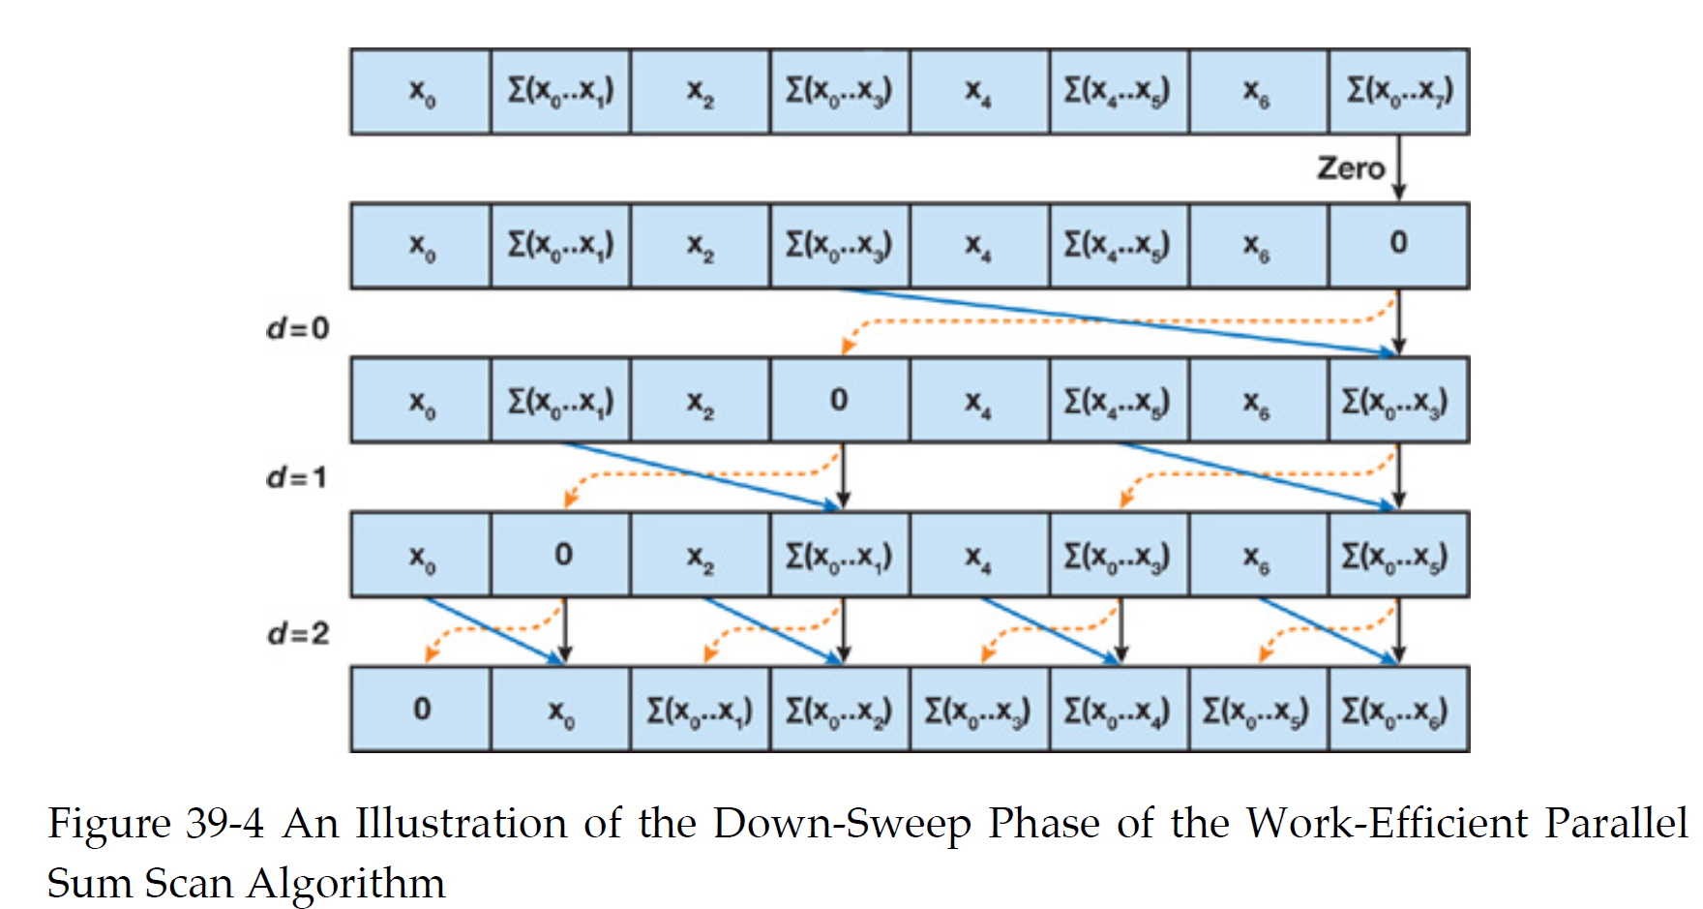
Down-Sweep Phase
exclusive scan

Slide 18
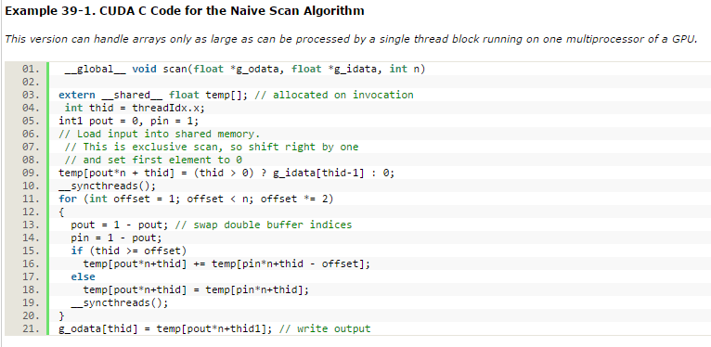
Naïve Scan Algorithm

Slide 19

Up-Sweep

Slide 20
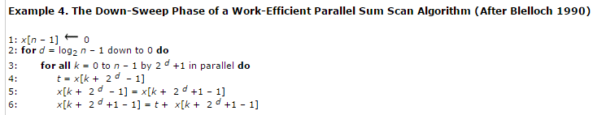
Down-Sweep

Slide 21
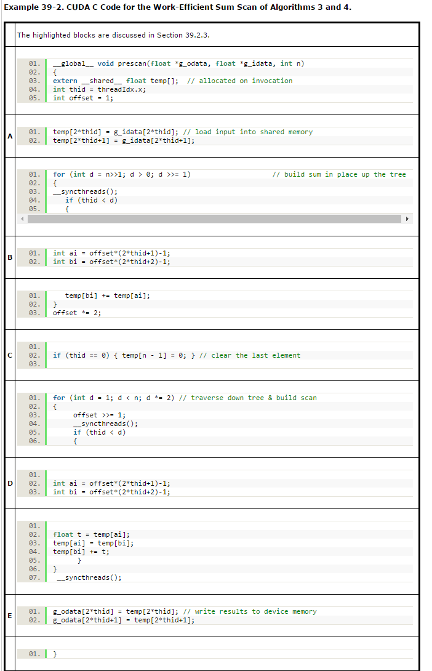

Slide 22
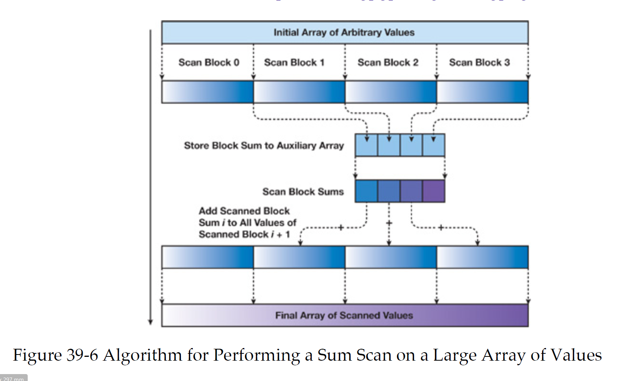
Large Array of Data
(final sum)
divide and conquer

Slide 23
Large Array Example
1 | 2 | 3 | 4 | 5 | 6 | 7 | 8 | 9 | 10 | 11 | 12 | 13 | 14 | 15 | 16
1 | 3 | 6 | 10 | 5 | 11 | 18 | 23 | 9 | 19 | 30 | 42 | 13 | 27 | 42 | 58
10 | 23 | 42 | 58
10 | 33 | 75 | 133
+
+
+
1 | 3 | 6 | 10 | 5 | 11 | 18 | 23 | 9 | 19 | 30 | 42 | 13 | 27 | 42 | 58

Slide 24
Application: Stream Compaction
Stream compaction takes an input V and a predicate p, and outputs only those elements in V for which p(v_{i} ) is true, preserving the ordering of the input elements.
But it seems hard to put them in the right place.

Slide 25
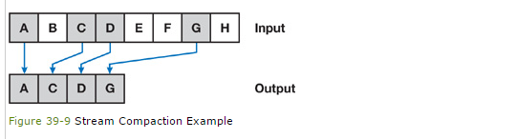
Stream Compaction

Slide 26
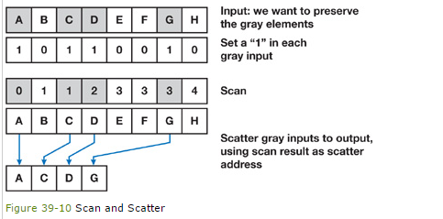
Stream Compaction

Slide 27
Applications of SCAN
Radix Sort, Quick Sort
String comnparison
Lexical anaalysis
Stream Compaction
Sparse Matrices
Tree operations
Histograms
Polynomial Evaluation
Solving recurrences

